Slide 1
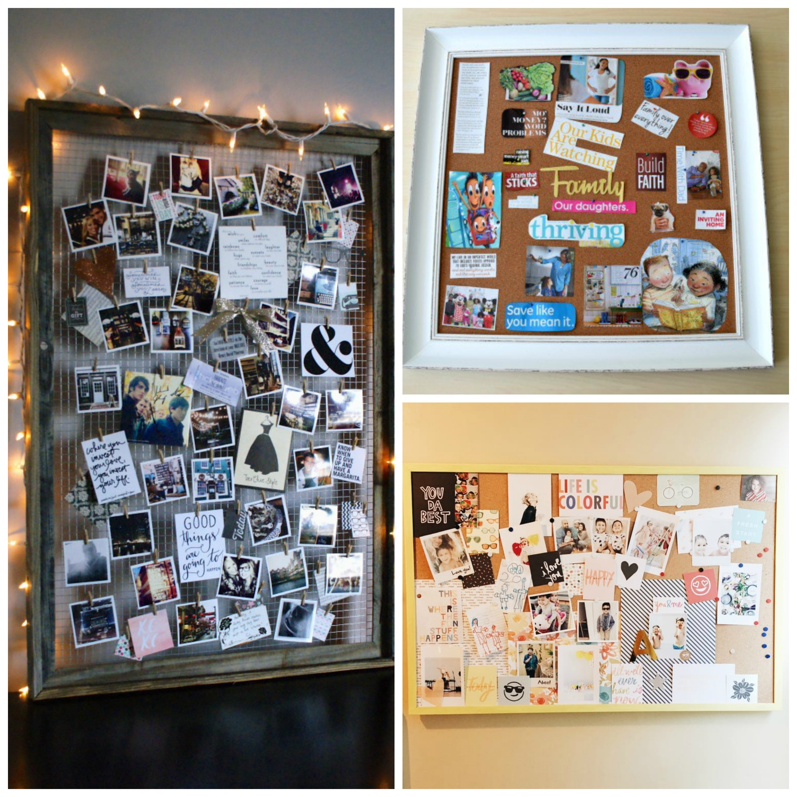
YOUR FUN AND EASY GUIDE TO CREATE A
Vision Board
WITH PURPOSE!

Slide 2
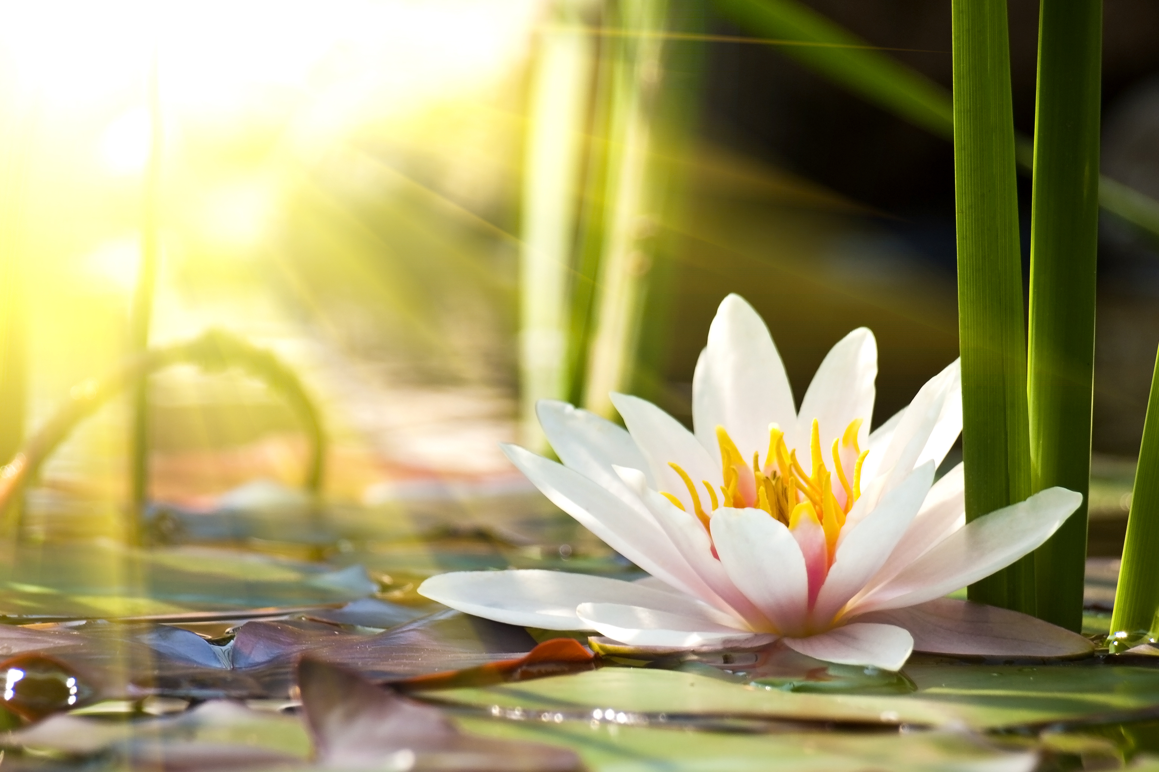
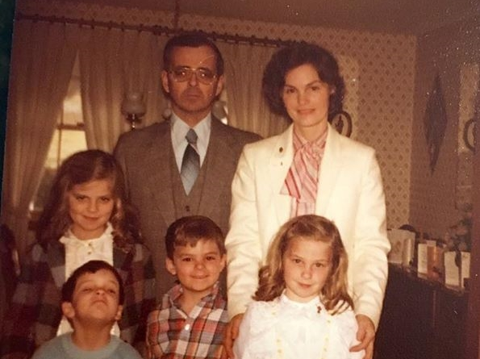
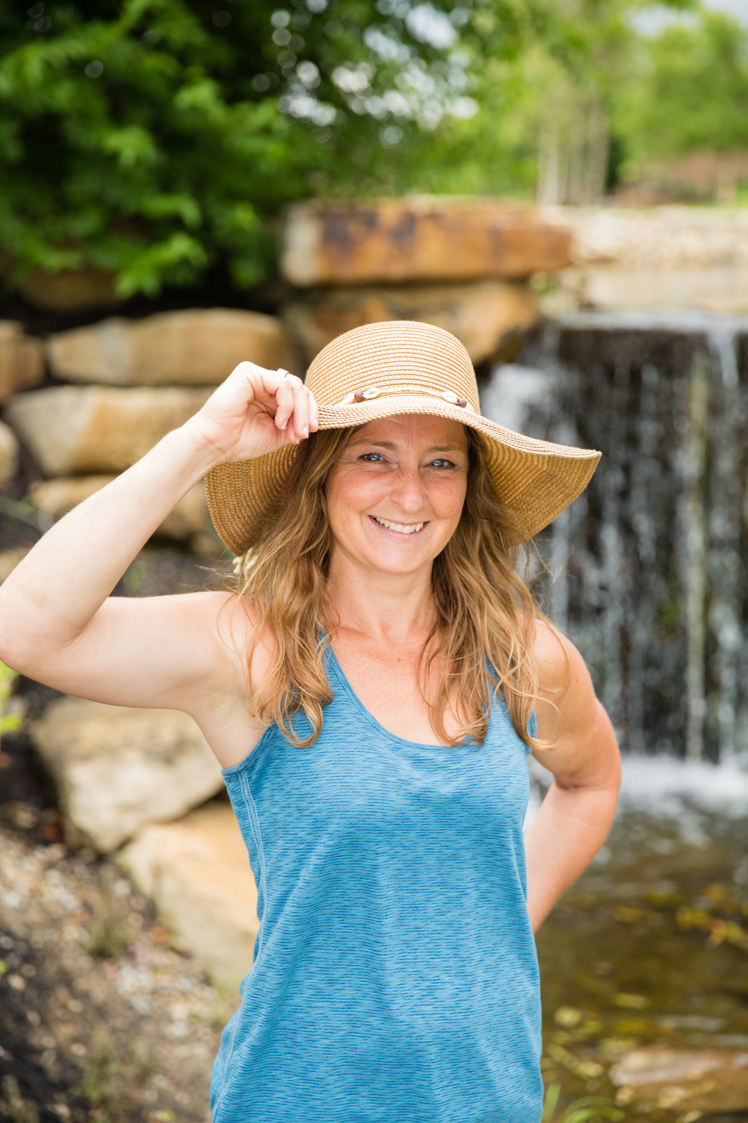
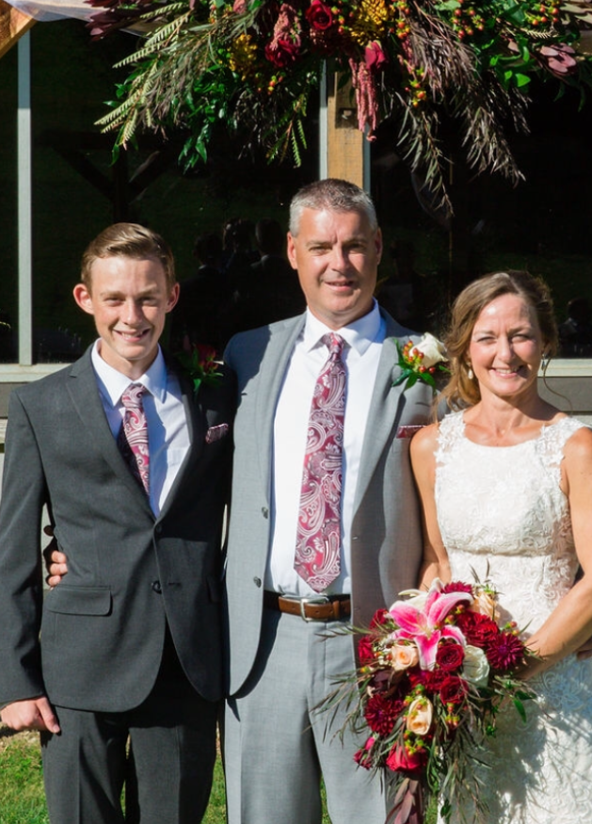
Christine Belcastro Soul Meets Body, LLC www.soulmeetsbodycoach.com Providing a Holistic Approach to Fitness, Wellness and Life!

Slide 3
Welcome Aboard,
I am so happy that you have decided to join me in embracing your vision, desires and purpose for the upcoming year. The Life Balance Wheel Activity started the ball rolling for you to see what areas of life need your focus and intention for lasting change to occur.
In order for a Vision Board to work, it needs to be created with intention and purpose in mind, within a positive environment and cultivated with a positive mindset. This Vision Board should act as a guide (anchor) for what you truly desire as an outcome (BIG MOFA).
Take a moment and look back at your Life Balance Wheel. Think about what the results mean to you internally. NOW, give yourself credit for how far you have come since last year. Create your own POSITIVE MINDSET and inspirational area before moving forward with intention.
Within this guide, you will find easy to follow handouts to assist you in planning your personalized vision board. HAVE FUN with YOUR PLAN!!
xoxo
Christine

Slide 4
THINK ABOUT IT?!?!
What ideas, desires, dreams do you want to turn into reality this year?
What are you most proud of this year?
Meaningful connections and relationships have you formed? New ones?
What new skills or knowledge did you learn and want to improve on this year?

Slide 5
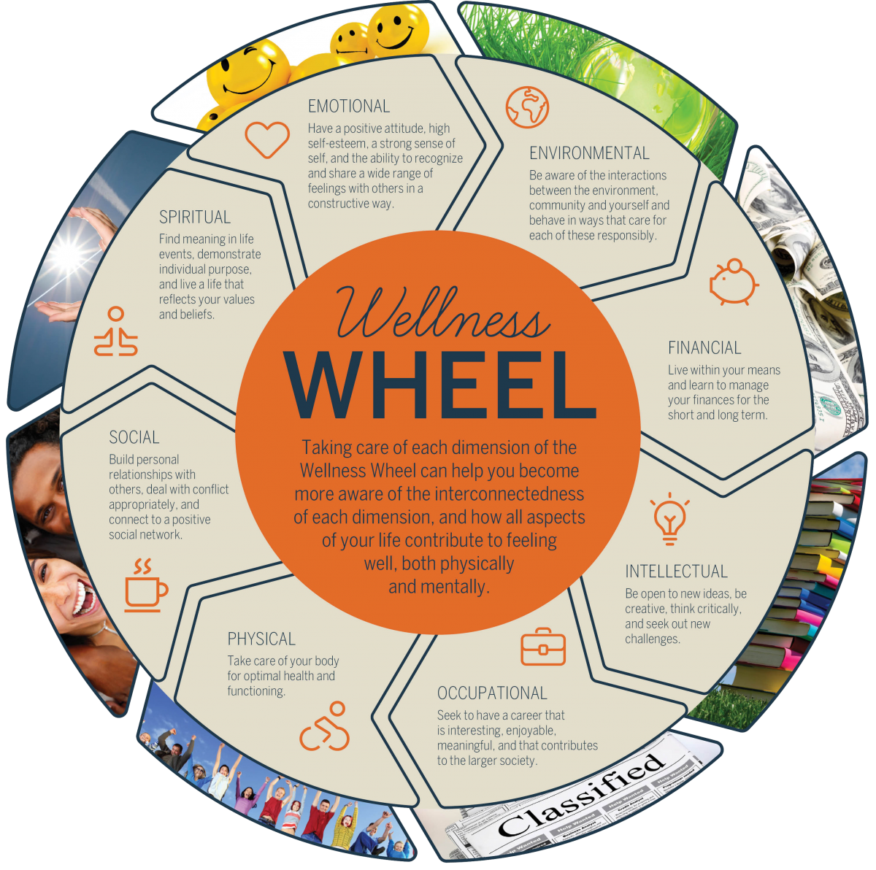

Slide 6
Bucket List 2019
Fill the Bucket with NEW and EXCITING things you want to experience this year.
Examples: places to see, conferences to attend, people to visit, new things/ hobbies to learn, new languages to learn

Slide 7
Quotes and Inspirational Phrases for 2019
This is the perfect place to jot down some inspirational quotes and motivational phrases, mantras, affirmations to keep you moving forward throughout the year.

Slide 8
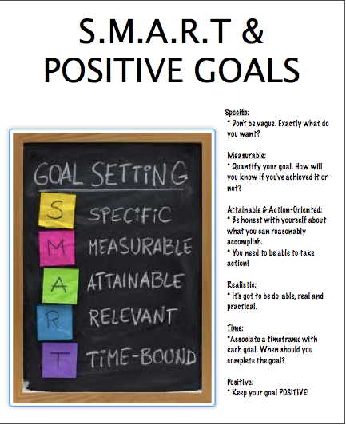
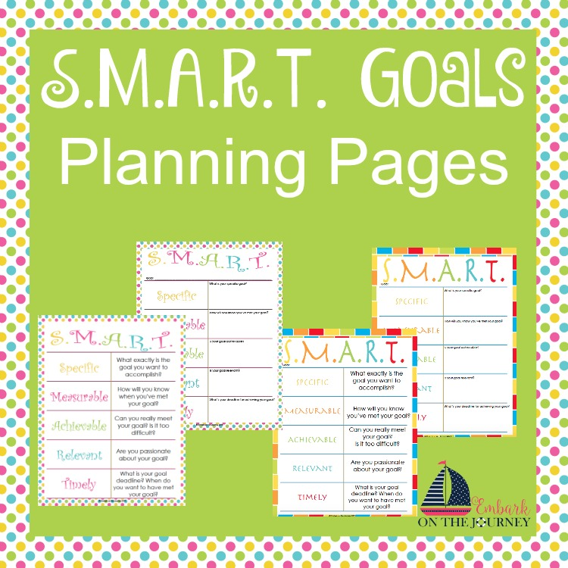
Time to SET THOSE GOALS!

Slide 9
The Fun Part!!!
Find photos, graphics, words, etc. that represent your goals, visions and desires for the rest of the year… GET CREATIVE!!! (use the handouts and create the vision board with purpose)
Make sure the vision board is being created in a positive environment, that is relaxed, inspirational, and full of calm and focused energy. (Music, essential oils diffusing, open space with positive mindset)
Hang the completed vision board somewhere that you will easily see it everyday. Look at your vision board each and every day and anchor your desired outcomes for the year. FOCUSED
Visualize your DREAM LIFE!!! Make it as VIVID as possible… focus on making it a reality. Let your vision board EXUDE HAPPINESS and POSITIVITY, SO WHEN YOU ARE DOWN or STUCK YOU CAN LOOK AT IT AND TAKE AWAY ANCORED POSITIVE ENERGY!!!

